Slide 1
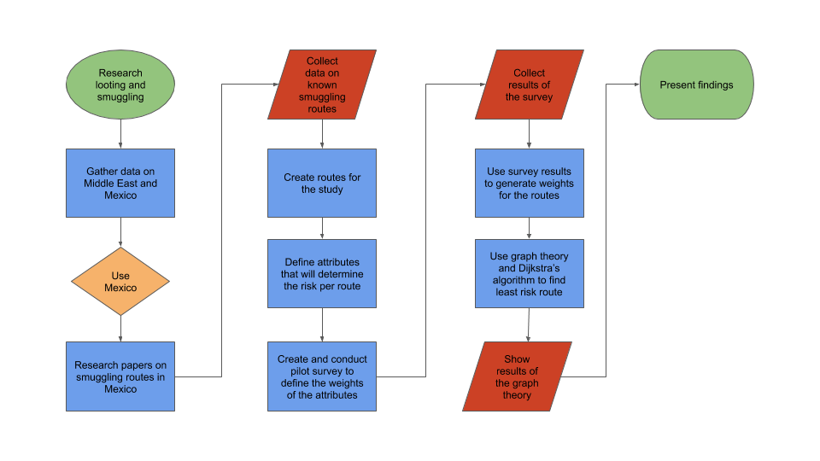


Workflow

Slide 2
City Information
City Information was gathered from several sources
City information was researched for crime rate, population, and cartel controlled
The data was tabulated for each of the cities defined in the routes
City | Crime Rate | Population | Cartel
Aguascalientes | 6.8 | 905,908 | Tierra Caliente
Celaya | 38.2 | 513,690 | Tierra Caliente
Ciudad Valles | 19.5 | 184,262 | Tamaulipas
Ciudad Victoria | 29.3 | 368,317 | Tamaulipas
Fresnillo | 42.3 | 231,904 | Tamaulipas
Sample table of city information

Slide 3
Route Information
Route information was determined from several resources
The linear distance was calculated from Google Earth
Path distance was determined from Google Maps
The circuitry was calculated for each route
The destination city’s population, crime rate, and cartel information was assigned to the routes
Route | Linear Distance (mi) | Path Distance (mi) | Circuity | Destination City Crime Rate | Destination Population
Zihuatanejo to Huetamo | 75.9 | 162.0 | 2.1 | 28.6 | 49,031
Zihuatanejo to Nueva Italia de Ruiz | 97.4 | 125.0 | 1.3 | 4.7 | 42,605
Nueva Italia de Ruiz to Uruapan | 25.3 | 36.2 | 1.4 | 74.6 | 348,643
Sample table of route information

Slide 4
Forced-Choice Survey: Results
The survey results were collected and processed to determine the weights of the route attributes
The attributes of ranking and score were used to calculate a composite values to be applied to the route’s attributes
The high/low was used to determine is a high or low value for a attribute equated to a risk level
Attribute | Score | Low/High | Ranking | Composite
Presence of Competing Gangs | 4.71 | Low | 1.86 | 3.93
Distance to Next Destination | 3.86 | Low | 2.43 | 3.21
Crime Rate | 3.14 | High | 3.14 | 2.50
Population Density | 2.86 | Low | 3.71 | 2.07
Complexity of the Route | 2.86 | Low | 3.86 | 2.00
Survey results and composite values

Slide 5
Route Weights
The route weights were calculated from the attributes of the routes and the survey results
The attributes for the routes were normalized between 0 and 1 using the min and max value for each attribute
The route’s attribute was multiplied by the survey composite values to form a weight for each route
The weight equates to the level of risk along each route segment
Route | Distance | Circuity | Crime | Population | Cartel | Route Weight
Zihuatanejo to Huetamo | 0.42 | 0.21 | 0.38 | 0.97 | 0.00 | 4.74
Zihuatanejo to Nueva Italia de Ruiz | 0.58 | 0.83 | 0.06 | 0.97 | 0.00 | 5.72
Nueva Italia de Ruiz to Uruapan | 0.98 | 0.72 | 1.00 | 0.78 | 0.00 | 8.73
Huetamo to Morelia | 0.57 | 0.51 | 0.55 | 0.50 | 0.00 | 5.28
Example of route weight data

Slide 6
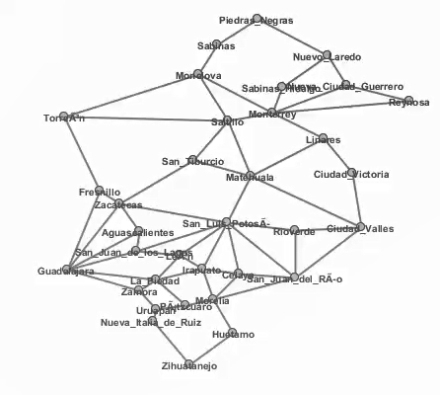
Graph Theory: Results
The routes with their respective weights were entered into Graph Tea
The cities were defined with the nodes
The routes were defined as edges with weights

Slide 7
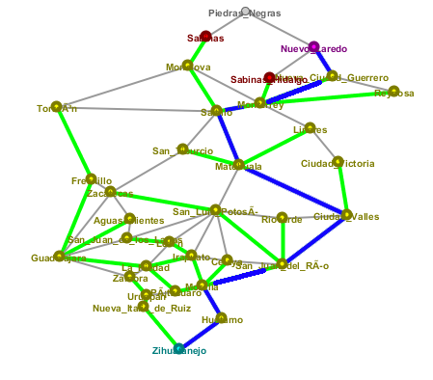
Graph Theory: Results
The path with the least amount of risk was determined
Within Graph Tea, the Dijkstra Algorithm was ran
The algorithm used the weights to determine the path with the least weights, in this case risk level
The path is shown below with the blue lines representing the route with the least amount of risk

Slide 8
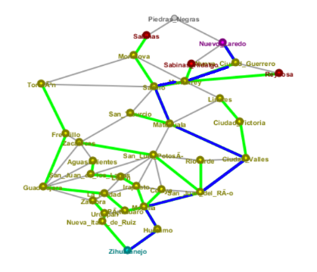
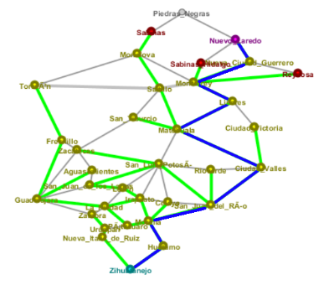
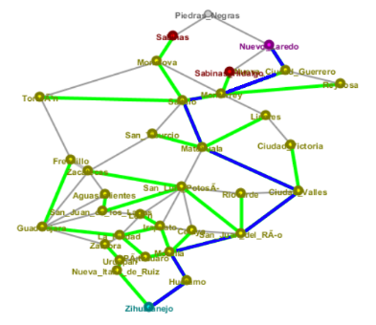
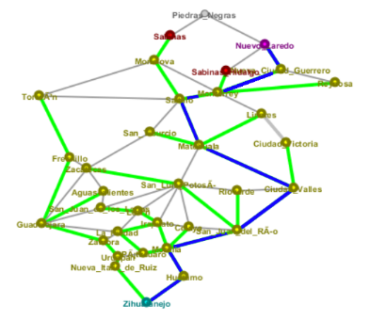
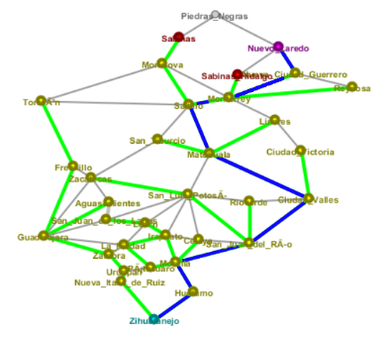
Graph Theory: Results
For completeness, a sensitivity analysis was conducted:
Within Graph Tea, the Dijkstra Algorithm was ran with four attributes only
The paths shown below confirm that the model is not highly sensitive to changes in input variables
Distance, Crime, Circuity, Population, Cartel Presence | Circuity, Crime, Population, Cartel Presence | Distance, Circuity, Crime, Cartel Presence | Distance, Circuity, Crime, Population | Distance, Circuity, Population, Cartel Presence | Distance, Crime, Population, Cartel Presence

